Slide 1

Bonus Topic: The Contagious Chessboard
Discrete Math is sometimes used in epidemiology, to model the spread of diseases.
Today: A simple example of a model of disease spread … with a proof.

Slide 2



We have an $n×n$ chessboard.
Some squares are initially infected.

Slide 3
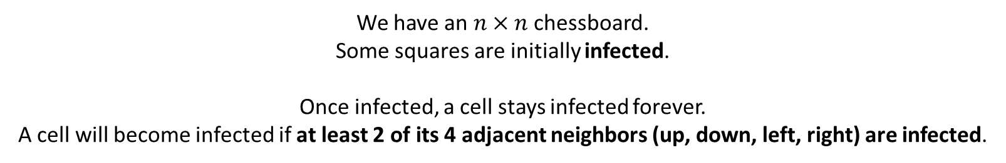
We have an $n×n$ chessboard.
Some squares are initially infected.
Once infected, a cell stays infected forever.
A cell will become infected if at least 2 of its 4 adjacent neighbors (up, down, left, right) are infected.

Slide 4
We have an $n×n$ chessboard.
Some squares are initially infected.
Once infected, a cell stays infected forever.
A cell will become infected if at least 2 of its 4 adjacent neighbors (up, down, left, right) are infected.
Infections can spread:
Newly-infected cell might infect others

Slide 5
We have an $n×n$ chessboard.
Some squares are initially infected.
Once infected, a cell stays infected forever.
A cell will become infected if at least 2 of its 4 adjacent neighbors (up, down, left, right) are infected.
Infections can spread:
Newly-infected cell might infect others

Slide 6
We have an $n×n$ chessboard.
Some squares are initially infected.
Once infected, a cell stays infected forever.
A cell will become infected if at least 2 of its 4 adjacent neighbors (up, down, left, right) are infected.
Infections can spread:
Newly-infected cell might infect others
This infection will eventually stop here.

Slide 7
The Question
What is the smallest number of squares you can choose to infect initially, so that eventually every cell in the chessboard gets infected?

Slide 8

The Question
What is the smallest number of squares you can choose to infect initially, so that eventually every cell in the chessboard gets infected?
$n^{2}$ initial infections works (Trivially)

Slide 9
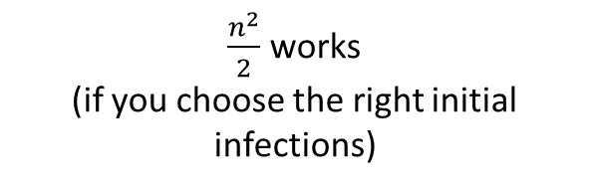
The Question
What is the smallest number of squares you can choose to infect initially, so that eventually every cell in the chessboard gets infected?
$\frac{n^{2}}{2}$ works
(if you choose the right initial infections)

Slide 10
The Question
What is the smallest number of squares you can choose to infect initially, so that eventually every cell in the chessboard gets infected?
How low can you go? Your goal:
Try to figure out a way to infect a small number of initial cells that will cause everything else to eventually get infected.
After that: How do you know your solution is optimal? Could you have infected even fewer cells?

Slide 11
The Answer
Theorem: There exists a way to infect the entire checkerboard by infecting n initial squares.
Proof:

Slide 12
The Answer
Theorem: There exists a way to infect the entire checkerboard by infecting n initial squares.
Proof:

Slide 13
The Answer
Theorem: There exists a way to infect the entire checkerboard by infecting n initial squares.
Proof:

Slide 14
The Answer
Theorem: There exists a way to infect the entire checkerboard by infecting n initial squares.
Proof:

Slide 15
The Answer
Theorem: There exists a way to infect the entire checkerboard by infecting n initial squares.
Proof:

Slide 16
The Answer
Theorem: There exists a way to infect the entire checkerboard by infecting n initial squares.
Proof:

Slide 17
The Answer
Theorem: There exists a way to infect the entire checkerboard by infecting n initial squares.
Proof:

Slide 18
The Answer
Theorem: There exists a way to infect the entire checkerboard by infecting n initial squares.
Proof:

Slide 19

The Answer
Theorem: There exists a way to infect the entire checkerboard by infecting n initial squares.
Can we do better?
Is there a way to infect the entire checkerboard by infecting n-1 initial squares?
Think about the perimeter of the infected region

Slide 20
The Answer
Theorem: There does not exist a way to infect the entire checkerboard by infecting n-1 initial squares.
Think about the perimeter of the infected region
Let’s try out an example:
Current Perimeter = 30

Slide 21
The Answer
Theorem: There does not exist a way to infect the entire checkerboard by infecting n-1 initial squares.
Think about the perimeter of the infected region
Let’s try out an example:
Current Perimeter = 30
New cell gets infected.
How does the perimeter change?

Slide 22
The Answer
Theorem: There does not exist a way to infect the entire checkerboard by infecting n-1 initial squares.
Think about the perimeter of the infected region
Let’s try out an example:
Current Perimeter = 30
New cell gets infected.
How does the perimeter change?
2 lines on the perimeter destroyed

Slide 23
The Answer
Theorem: There does not exist a way to infect the entire checkerboard by infecting n-1 initial squares.
Think about the perimeter of the infected region
Let’s try out an example:
Current Perimeter = 30
New cell gets infected.
How does the perimeter change?
2 lines on the perimeter destroyed
2 lines on the perimeter created

Slide 24
The Answer
Theorem: There does not exist a way to infect the entire checkerboard by infecting n-1 initial squares.
Think about the perimeter of the infected region
Let’s try out an example:
Current Perimeter = 30
New cell gets infected.
How does the perimeter change?
2 lines on the perimeter destroyed
2 lines on the perimeter created
Perimeter is unchanged!

Slide 25
The Answer
Theorem: There does not exist a way to infect the entire checkerboard by infecting n-1 initial squares.
Think about the perimeter of the infected region
Lemma:
Each time a new cell is infected, the perimeter of the infected cells does not increase.
Proof Sketch:
Each new infected square has 4 sides.

Slide 26
The Answer
Theorem: There does not exist a way to infect the entire checkerboard by infecting n-1 initial squares.
Think about the perimeter of the infected region
Lemma:
Each time a new cell is infected, the perimeter of the infected cells does not increase.
Proof Sketch:
Each new infected square has 4 sides.
At least 2 of the 4 sides were previously in the perimeter (otherwise, the cell wouldn’t become infected).

Slide 27
The Answer
Theorem: There does not exist a way to infect the entire checkerboard by infecting n-1 initial squares.
Think about the perimeter of the infected region
Lemma:
Each time a new cell is infected, the perimeter of the infected cells does not increase.
Proof Sketch:
Each new infected square has 4 sides.
At least 2 of the 4 sides were previously in the perimeter (otherwise, the cell wouldn’t become infected).
After infection, those 2 (or more) sides are removed from the perimeter.

Slide 28
The Answer
Theorem: There does not exist a way to infect the entire checkerboard by infecting n-1 initial squares.
Think about the perimeter of the infected region
Lemma:
Each time a new cell is infected, the perimeter of the infected cells does not increase.
Proof Sketch:
Each new infected square has 4 sides.
At least 2 of the 4 sides were previously in the perimeter (otherwise, the cell wouldn’t become infected).
After infection, those 2 (or more) sides are removed from the perimeter.

Slide 29
The Answer
Theorem: There does not exist a way to infect the entire checkerboard by infecting n-1 initial squares.
Think about the perimeter of the infected region
Lemma:
Each time a new cell is infected, the perimeter of the infected cells does not increase.
Proof Sketch:
Each new infected square has 4 sides.
At least 2 of the 4 sides were previously in the perimeter (otherwise, the cell wouldn’t become infected).
After infection, those 2 (or more) sides are removed from the perimeter.
The other 2 (or fewer) sides are added to the perimeter.

Slide 30
The Answer
Theorem: There does not exist a way to infect the entire checkerboard by infecting n-1 initial squares.
Lemma:
Each time a new cell is infected, the perimeter of the infected cells does not increase.

Slide 31
The Answer
Theorem: There does not exist a way to infect the entire checkerboard by infecting n-1 initial squares.
Lemma:
Each time a new cell is infected, the perimeter of the infected cells does not increase.
Proof:
Once the entire checkerboard is infected, the perimeter of the infected region is 4n.

Slide 32
The Answer
Theorem: There does not exist a way to infect the entire checkerboard by infecting n-1 initial squares.
Lemma:
Each time a new cell is infected, the perimeter of the infected cells does not increase.
Proof:
Once the entire checkerboard is infected, the perimeter of the infected region is 4n.
Therefore, by our Lemma, the initial perimeter must be at least 4n.

Slide 33
The Answer
Theorem: There does not exist a way to infect the entire checkerboard by infecting n-1 initial squares.
Lemma:
Each time a new cell is infected, the perimeter of the infected cells does not increase.
Proof:
Once the entire checkerboard is infected, the perimeter of the infected region is 4n.
Therefore, by our Lemma, the initial perimeter must be at least 4n.
So the initial number of infected squares is at least n.
Done!

Slide 34
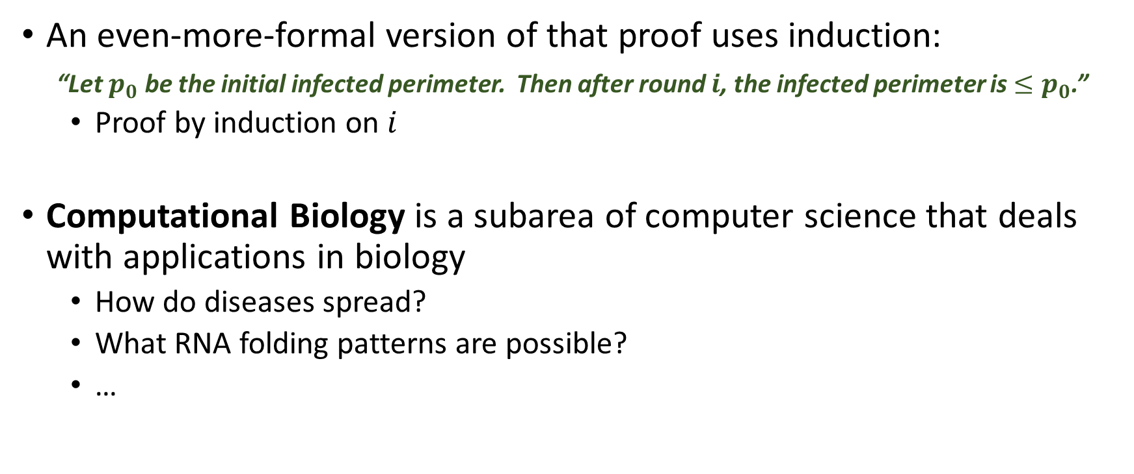
Wrapup
An even-more-formal version of that proof uses induction:
“Let $p_{0}$ be the initial infected perimeter. Then after round $i$, the infected perimeter is $≤p_{0}$.”
Proof by induction on $i$
Computational Biology is a subarea of computer science that deals with applications in biology
How do diseases spread?
What RNA folding patterns are possible?
…

